Slide 1
FOOD SURVEY ANALYSIS
BY MANDEEP KAUR

Slide 2
AGENDA
Introduction.
Problem Statement and data source.
Objective and Methodology.
Solution Description.
Impact.

Slide 3
Introduction
Online survey of around 100 people to analyze most frequent food which is being eaten by the people during this COVID-19 pandemic.

Slide 4
Problem statement and data sources
Understanding the pattern of food intake and preparing visual analysis of different groups and items.
What is the impact of unhealthy food intake and how many people are being affected by its usage.
What type of food establishment has mostly affected them.
How can we cure this problem.
Data is collected from google survey. Survey of around 100 people of year 2021.

Slide 5
Objective and methodology
Understanding the pattern of food intake (healthy and unhealthy) and analyzing there health reports through the survey.
How many people intake unhealthy food and how many people are able to keep themselves fit.
What kind of food is mostly being preferred by them and what are the impacts of those food items on human body.
How many people are trying to keep themselves healthy and how many of them are facing health related problems like obesity and diabetes.
Which food business establishment is growing rapidly during covid 19 pandemic.

Slide 6
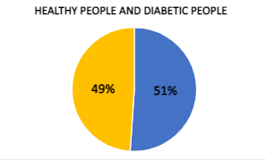
Solution description
As shown in the pie chart most of the people are diabetic and rest of them are non diabetic.
This survey shows us that diabetic patient’s ratio is constantly increasing.
Out of 20 people there are approximately 13 diabetic patients.

Slide 7
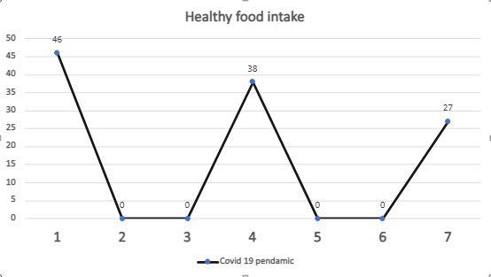
Healthy food intake Analysis of people during covid-19
At first the ratio of unhealthy people is shown.(46)
In the other hand we have the ratio of those people who are diabetes patient.(38)
And last figure is showing the analyses of those people who are physically healthy and follow a healthy diet.(27)

Slide 8
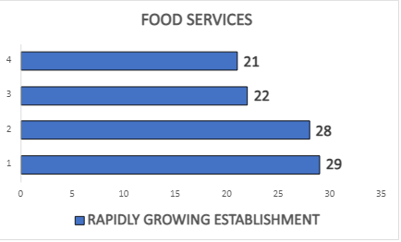
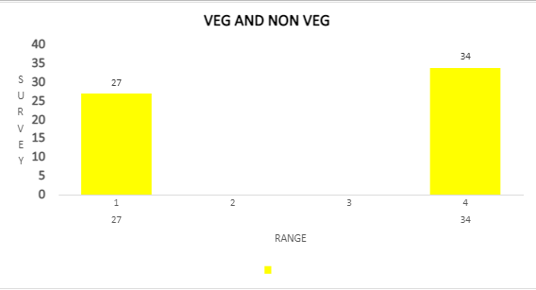
Food establishment approach
Street food carts
Indian dhaba
Food stores
Five star restaurants
Analysis of food establishments
In the first figure the ratio of vegetarian people is less than the ratio of non vegetarian people.
And in next figure Five star restaurants are the most preferred food establishment platforms during Covid- 19 pandemic.

Slide 9
Impact
Most of the people are not able to follow proper diet.
They can adapt some good food habits and they should avoid the maximum usage of outdoor food.
Restaurants are the most preferred food establishments during covid 19 pandemic through this analysis its clearly predictable that people like ordering food from restaurants instead of other platforms .

